Slide 1
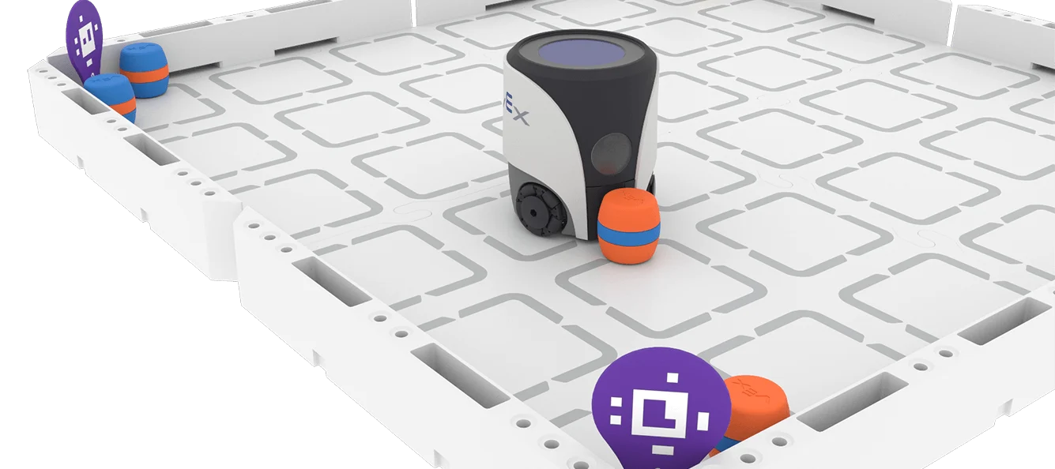
RECORDING MY LEARNING JOURNEY
STUDENT NAME: _______________
YEAR 9 STEM DIGITAL
PORTFOLIO

Slide 2
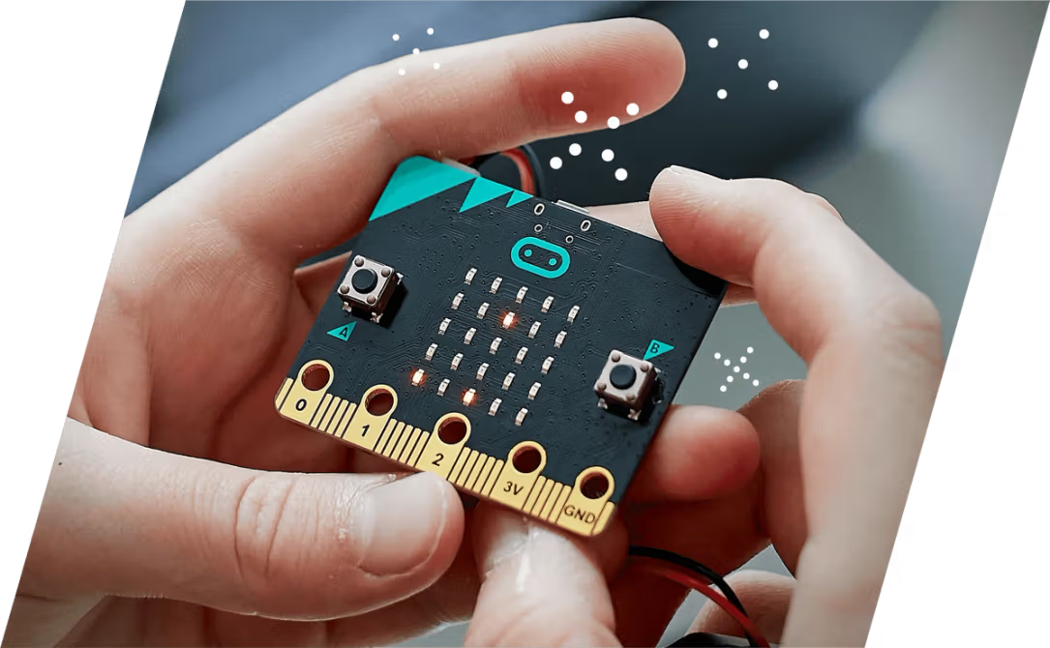
MY ROBOTICS EXPERIENCE
Have you used robots, coding platforms, or block-based programming before? Describe any experience — even playing games or using apps counts!
✏️ [Your response here]
I have not used any robots or any types of coding other than what we have already done in stem. I have played some games before on my laptop, nothing more than that. I also have done digital makers in past years.

Slide 3

WHAT I HOPE TO LEARN
Write 2–3 goals you have for this robotics unit. What skills, concepts, or experiences are you most excited about? What do you want to be able to do by the end?
✏️ [Your response here]
I hope to learn how to drive a robot by coding it through my laptop and not having to use the controller. I also hope we can use the big robots to pick up things and do stuff.

Slide 4

UNIT GUIDE
HOW TO USE EACH UNIT
WHAT YOU WILL DOCUMENT
TIPS FOR SUCCESS
Each unit slide includes the same prompts to help you document your learning consistently. Fill in each section as you work through the unit activities.
Delete the prompts once each section is completed.
Add more slides as required.
Each unit includes: What I Learned, Key Vocabulary (3-5 terms), Code & Programming Notes, Challenges & Solutions, Pros & Cons, and Reflection Questions. Complete each section after finishing the unit activities.
Use your own words. Include screenshots or sketches where possible. Be honest in your reflections. Ask your teacher if you are unsure what to write in any section.

Slide 5
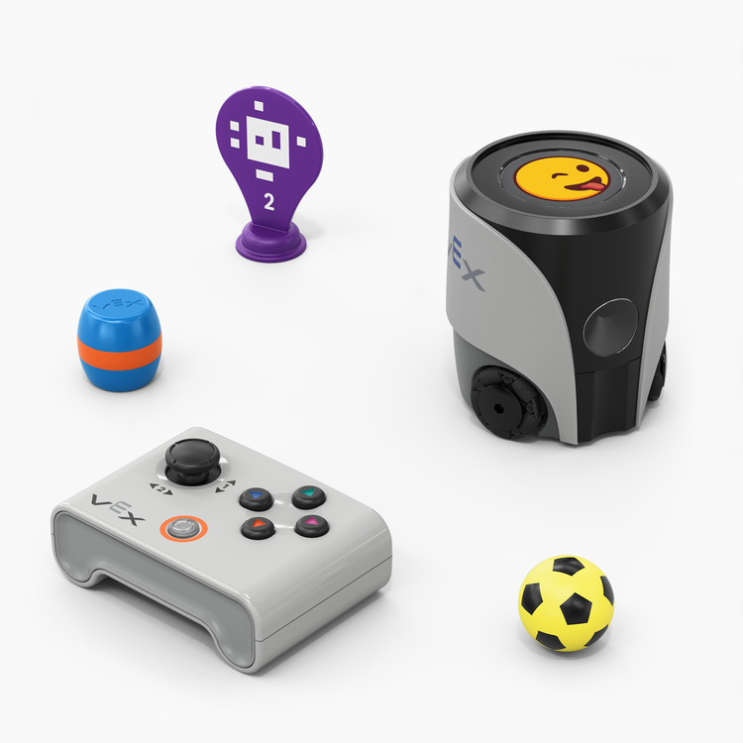
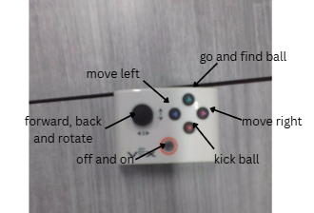
UNIT 1 – DRIVE WITH A CONTROLLER
Add an annotated image of the remote that explains how to use it.
CHALLENGES & SOLUTIONS
What difficulties did you face? How did you overcome them?
I didn’t face to many difficulties, other than trying to connect the robot to my laptop to code it on my laptop.
PROS & CONS OF USING A REMOTE
Pros: you have lots of control over the robot
Cons: you can’t just watch it, you have to move it manually
REFLECTION
What surprised you most about driving the robot? What would you do differently next time?
I liked how you can press a button for it to go find the soccer ball. I think next time I will use the codes.
WHAT I LEARNED
Describe the key concepts you explored in this unit. How does the VEX AIM robot respond to controller inputs? What did you discover about driving and directional control?
KEY VOCABULARY
Move left 2. move right
Kick ball 4. go and find ball

Slide 6
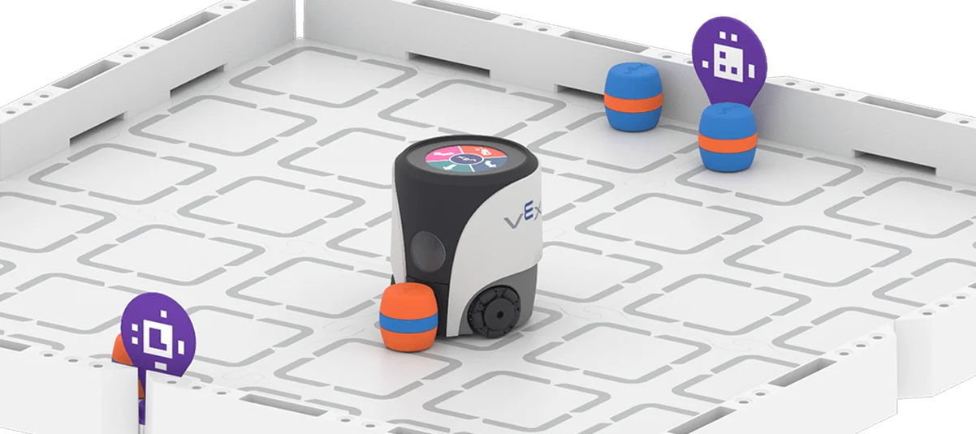
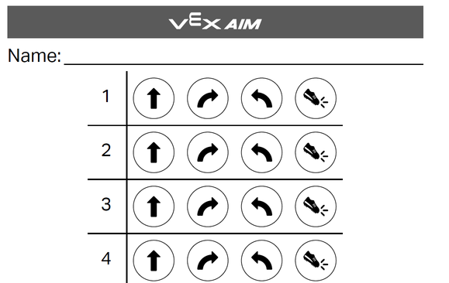
UNIT 2 – TOUCH TO CODE
WHAT I LEARNED
Describe the key concepts from this unit:
• How button inputs trigger robot movement commands
• How to sequence commands using button coding logic
• How the robot responds to different button signals
KEY VOCABULARY
• Button Event / Trigger: different options you can choose to code.
• Command Sequence: the buttons you chose then performs the sequence
CODE / PROGRAMMING NOTES
Sketch or describe your button coding program below:
• Button used: forward, right, left, kick
• Robot action triggered: forward, right, left, kick
• Planning notes / sequence diagram:
CHALLENGES & SOLUTIONS
• Challenge I faced: the wheels made it turn weirdly
• How I solved it: got a new robot
REFLECTION
• What surprised me about button coding?
How you don’t have to use the controller.
• How did planning my sequence help?
To make sure I don’t stuff it up.
• What would I improve next time?
Make sure I plan extra well.
PROS & CONS OF BUTTON CODING
Pros: you don’t have to use the controller
Cons: sometimes you can accidentally code the robot to do something wrong, then you have to start over

Slide 7
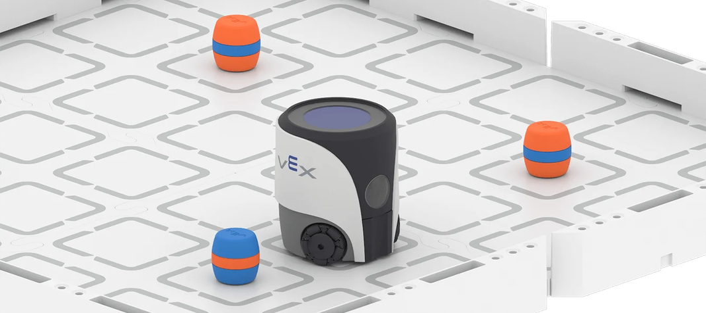
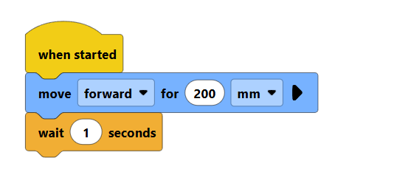
UNIT 3 – MOVE AROUND OBSTACLES
WHAT I LEARNED
Describe how block coding was used to program the robot to detect and navigate around obstacles. What movement commands did you use? How did the robot "decide" when to turn or stop?
KEY VOCABULARY
• Block code • Obstacle detection • Loop • Conditional • Sensor input
CODE / PROGRAMMING NOTES
Sketch or describe your block code sequence below. Which blocks did you use to move, detect, and avoid obstacles? Note any key logic or order of steps.
When started, move forward 200 mm, then wait 1 second.
PROS & CONS OF BLOCK CODING
Pros: you can save it to the robot to use for next time.
Cons: hard and more complicated to code.
CHALLENGES & SOLUTIONS
Describe one difficulty you faced and how you solved it.
I struggled connecting the robot to my laptop, but then I plugged it in with the cord.

Slide 8
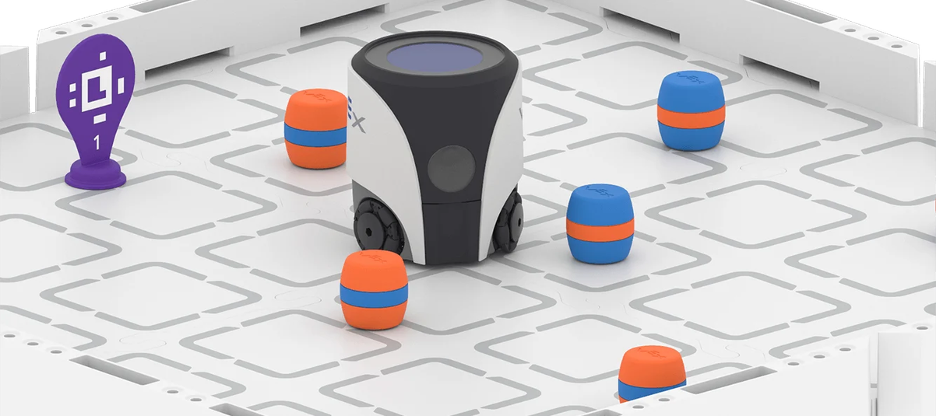
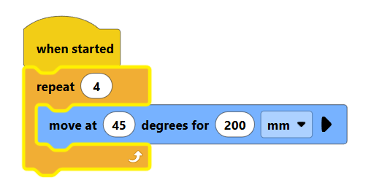
UNIT 4 – NAVIGATE DIAGONAL PATHS
WHAT I LEARNED
Describe the key concepts from this unit. How does the VEX AIM robot navigate diagonal paths? What block coding commands did you use to control direction and movement angles?
KEY VOCABULARY
• Diagonal movement:
• Heading/direction block:
• Angle/degree:
• Path planning:
• Coordinate navigation:
REFLECTION
• What surprised you about navigating diagonal paths?
• How did block coding help you plan the robot's route?
• What would you change or improve in your code next time?
CODE / PROGRAMMING NOTES
Sketch or describe your block code sequence for diagonal movement. What blocks did you combine? What values did you use for angles or headings?
CHALLENGES & SOLUTIONS
What difficulties did you face when coding diagonal paths? How did you solve them?
I was surprised it wasn’t too hard to code.
It helped me since it was easy to understand, and explains it well.
I would make it move more times on an angle.
Moving on an angle

Slide 9
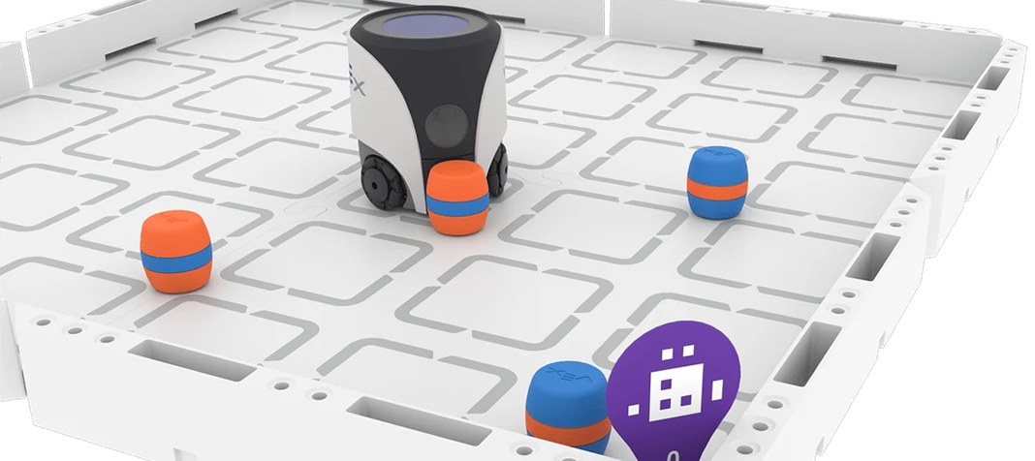
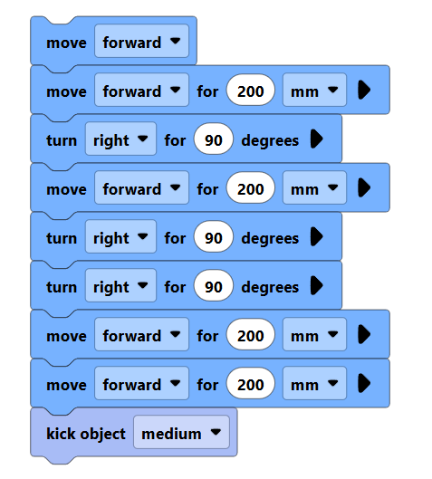
UNIT 5 – TRANSPORT CARGO
WHAT I LEARNED
Describe what you discovered about using 'turn to heading' blocks to navigate the robot. How does the heading system work?
KEY VOCABULARY
• Turn to Heading
• Absolute Heading
• Degrees / Direction
• Cargo / Payload
• Navigation Path
CODE / PROGRAMMING NOTES
Sketch or describe your heading-based program below. What heading values did you use to transport cargo successfully?
CHALLENGES & SOLUTIONS
What went wrong? How did you fix it?
Do this code x4
PROS & CONS OF TURN TO HEADING
Pros: the route isn’t to hard ________________________________
Cons: hard to connect aimbot________________________________
REFLECTION
How did using headings make your program more precise? What would you improve?

Slide 10
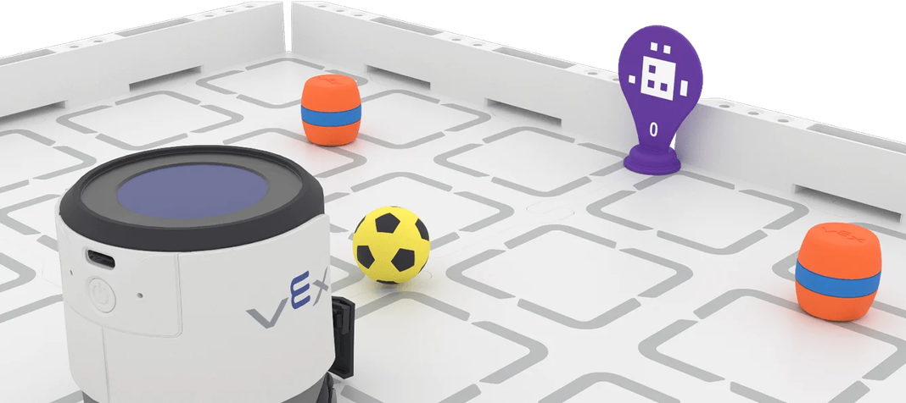
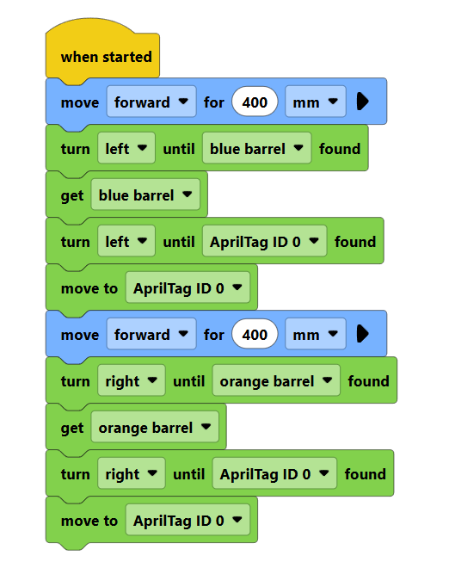
UNIT 6 – FINDING & TRANSPORTING CARGO
WHAT I LEARNED
Describe how the VEX AIM robot uses AI Vision to locate and transport cargo autonomously. What commands or blocks did you use to detect objects and navigate toward them? How did the robot decide when to pick up or move cargo?
KEY VOCABULARY
List 3–5 important terms (e.g., AI Vision sensor, autonomous navigation, object detection, pathfinding, cargo transport):
Ai vison
2. Orange barrel
3. sensor
4. tag
5. detect
CODING STRATEGIES & PROGRAM NOTES
Sketch or describe your program logic below. How did you structure your code to find and transport cargo? What sensor inputs triggered each action?
CHALLENGES & SOLUTIONS
What difficulties did you encounter with the AI Vision sensor or cargo transport? How did you solve them?
Code for unit 6
REFLECTION QUESTIONS
• How does autonomous navigation differ from manual control?
You don’t have to control it yourself.
• What factors affected the AI Vision sensor's accuracy?
Nothing affected the accuracy.
• What improvements would you make to your program?
I would make the code more advanced.
• What did this unit teach you about real-world robotics?
It taught me about AI vision and sensors.

Slide 11
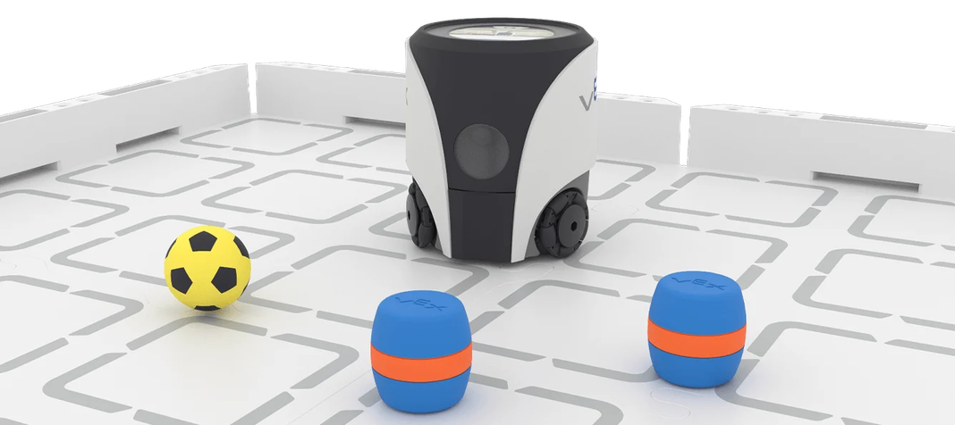
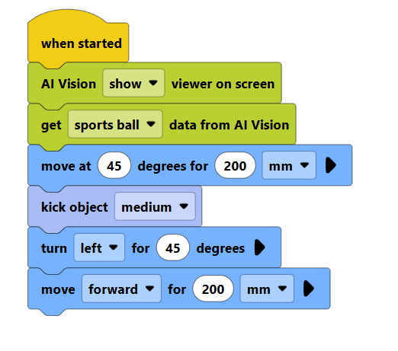
UNIT 7 – EXPLORING AI VISION
WHAT I LEARNED
Describe how the VEX AIM robot's AI Vision sensor works and what it can detect.
KEY VOCABULARY
• AI Vision Sensor
• Light sensitivity
• Detection threshold
• Environmental variable
• Sensor calibration
INVESTIGATION STEPS
Document your steps here:
FINDINGS & REFLECTION
How did light and other factors impact the AI Vision sensor?
The light didn’t impact it, but people in the background did
What changes improved sensor accuracy?
Placing the ball in front of the camera
What would you test next time?
Finding barrels and collecting them
Do this code twice

Slide 12
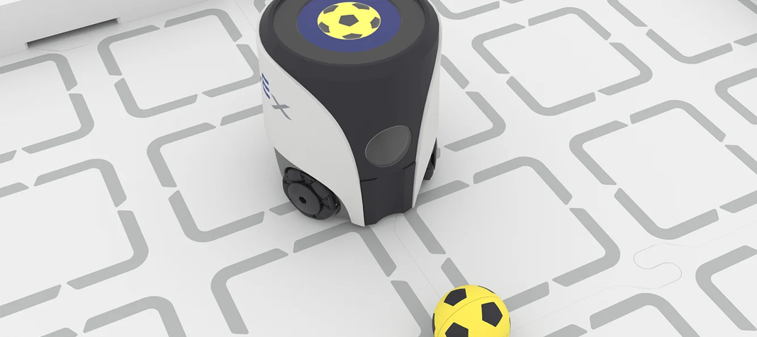
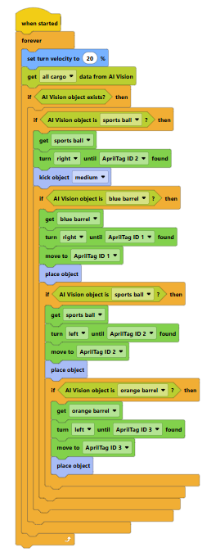
UNIT 8 – CONTROLLING DECISIONS
What I Learned:
Describe how you used conditional logic and decision-making in your code. How did the robot "decide" what action to take based on sensor input or conditions?
Key Vocabulary:
List 3–5 important terms (e.g., conditional, if/else, Boolean, sensor trigger, decision tree) coordination, ai vision, control
Code / Programming Notes:
Sketch or describe the decision-making logic you programmed. What conditions did you set? What actions followed each condition?
Capstone Preparation Reflection:
How does controlling decisions connect to the Delivery Dash challenge? Which skills from Units 1–7 will you integrate? What is your biggest strength going into the capstone? I used some of the skills from unit 5, 6 and 7.

Slide 13

DELIVERY DASH
CAPSTONE CHALLENGE – PLANNING
Project Goal:
My Approach / Strategy: to grab multiple barrels at a time
Steps I Plan to Take: use ai vision to find barrels and bring back to tag
Resources / Code I Will Use: ai vision
Potential Challenges: complete quicker and less steps each time

Slide 14
DELIVERY DASH
EXECUTION & CODING
Steps I took to complete the Delivery Dash:
Key coding highlights / snippets used:
RESULTS & REFLECTION
Outcomes & robot performance: robot performed well and completed task
What went well: all of it
Lessons learned & improvements for next time: I learned how to do delivery dash

Slide 15
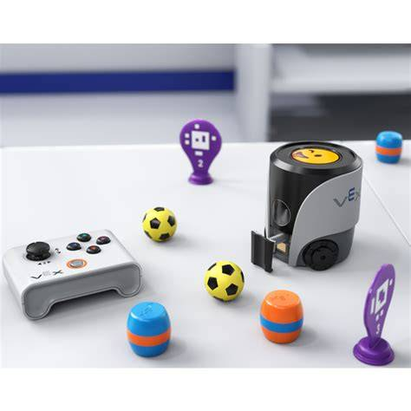
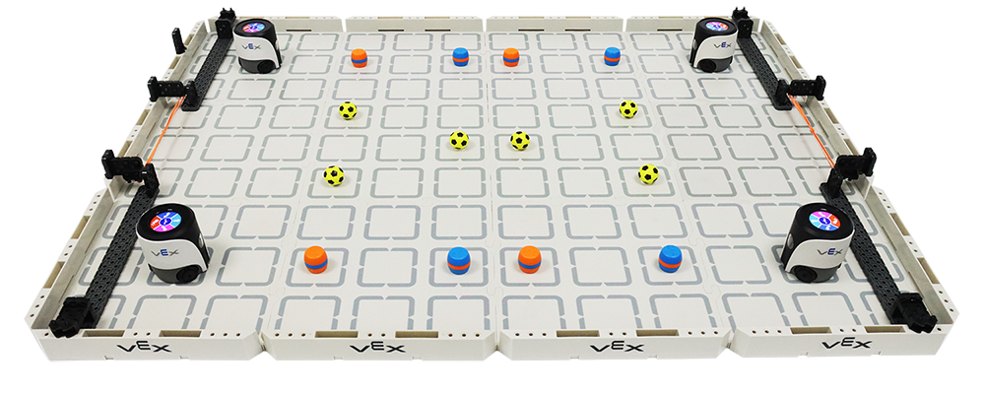
SHOWCASE PLANNING
DEMO ACTIVITY
MATERIALS NEEDED
Activity Description:
Demonstrate your VEX Aimbot robot to parents and visitors. Show how your robot navigates, avoids obstacles, and completes tasks using your chosen coding approach.
Step-by-Step Instructions:
Set up the robot and arena
Explain your coding method
Run a live demonstration
Invite visitors to try the controller
Answer questions about your learning
Materials Checklist:
• VEX Aimbot robot (charged)
• Remote controller
• Laptop with VEX coding environment
• Arena/obstacle course setup
• Printed program or cue cards
Expected Learning Outcomes:
Visitors will understand how students use block code, AI vision, and remote control to program autonomous and manual robot behaviours in real-world challenges.

Slide 16

SHOWCASE CODING OPTIONS
REMOTES: MANUAL CONTROL
BUTTON CODING: INTERACTIVE TRIGGERS
BLOCK CODE: AUTOMATED SCRIPTS
Use a controller to drive the robot live during the demo. Great for showing visitors how to steer and interact with the robot in real time. Simple, engaging, and easy to explain to parents and guests.
Program specific buttons to trigger robot actions. Visitors can press a button and watch the robot respond. A great way to show how simple inputs create programmed outputs and introduce coding logic.
Set up a fully automated sequence using block code. The robot runs a pre-programmed routine independently. Ideal for demonstrating autonomous navigation, obstacle avoidance, or cargo transport without manual input.

Slide 17
OVERALL UNIT REFLECTION
MY LEARNING SUMMARY
🏆 My biggest achievement:
💡 Challenges I overcame:
🤖 How my understanding improved:
🚀 Skills I'll take forward:

Slide 18
